Slide 1
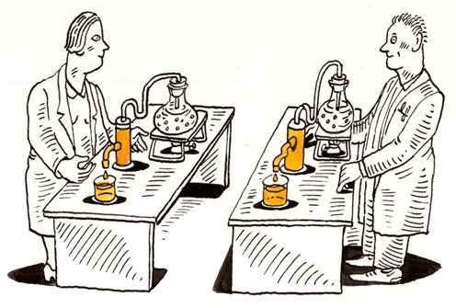
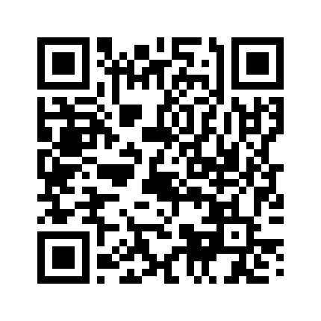
Qualtrics for Research Data Collection
Nelson Roque, PhD
UCF, Department of Psychology
Scan for
Slides & Code available on GitHub
Notes:
Qualtrics for Research Data Collection Friday, March 3, 2023 3 p.m. to 4 p.m. Virtual workshop
Qualtrics is a tool frequently used for research data collection through surveys. This workshop will teach survey design tips for reproducible survey research; and data wrangling of Qualtricsdata – the process of cleaning and transforming raw data into data suitable for analysis.
Registration link: https://ucf.qualtrics.com/jfe/form/SV_0AL2md8bJpwxuBM

Slide 2
About this Workshop
Qualtrics is a tool frequently used for research data collection through surveys.
This workshop will teach survey design tips for reproducible survey research; and data wrangling of Qualtrics data – the process of cleaning and transforming raw data into data suitable for analysis.
All slides and code will be made available on Github
https://github.com/nelsonroque/contextlab_qualtrics_workshops
Notes:
https://github.com/nelsonroque/contextlab_qualtrics_workshops

Slide 3
Workshop Learning Objectives
Describe various principles, tools and techniques supportive of collecting data on Qualtrics.
Develop a code-only pipeline to allow reproducibility of data prep and analyses.
Learn about data wrangling principles (e.g., tidy data)
Import, pre-process & visualize data using R

Slide 4
What is Reproducible Science?

Slide 5
In a 2016 survey published in Nature, over 70% of 1576 researchers
who attempted to replicate
another scientist's experiment
were unsuccessful.
Notes:
A reproducibility crisis (Ioannidis, 2005; Open Science Collaboration, 2015) has emerged as a threat to the scientific enterprise.
Ioannidis, John P A. 2005. “Why Most Published Research Findings Are False.” PLoS Medicine 2 (8): e124. doi:10.1371/journal.pmed.0020124.
Munafò, M. R., Nosek, B. A., Bishop, D. V., Button, K. S., Chambers, C. D., Percie du Sert, N., ... & Ioannidis, J. (2017). A manifesto for reproducible science. Nature human behaviour, 1(1), 1-9.
Open Science Collaboration. 2015. “Estimating the Reproducibility of Psychological Science.” Science 349 (6251): aac4716–aac4716. doi:10.1126/science.aac4716.

Slide 6
How Can We Support Reproducible Science?
Making entire scientific process transparent (as allowable; often required by law, grants).
Sharing experiment, raw data, and analysis code
Detailed methods sections
Sharing stimulus sets
Being able to walk through a data analysis start (load raw data) to finish (manuscript analyses) in code
Following FAIR Principles
Pre-registering hypotheses and analysis plans (e.g., on OSF)
Notes:
More on this: https://www.displayr.com/what-is-reproducible-research/

Slide 7
Benefits of Reproducible Research
Increased likelihood that the research will be correct
Reproducibility makes it easier to check the research
It is easier to reproduce the research independently
Easier to extend the research
Reusable code and instruction resulting in increased efficiencies
https://www.displayr.com/what-is-reproducible-research

Slide 8
How Can Using Qualtrics Support Reproducible Science?
Exporting survey items via export to Word Document and export to Qualtrics Import Format (supporting interoperability)
Sharing workflows that automate scheduled protocols and related notification language
Sharing Qualtrics libraries of items

Slide 9
Lessons Learned Working
with Qualtrics Data

Slide 10
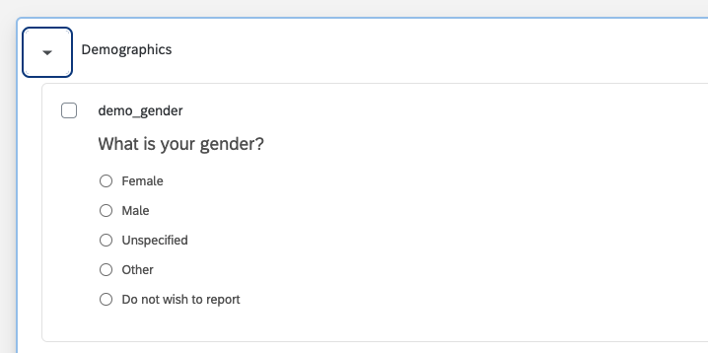
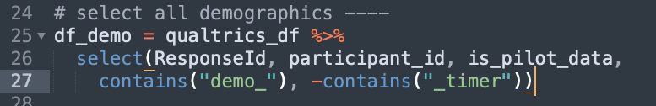
Qualtrics Data: Your Future BFF
Survey bloat – finding what you need in a large survey
Solution: prefix questions with helpful identifiers for grouping ‘like’ questions
Downstream in R, can easily select columns of interest without typing all column names (e.g., using starts_with, contains)

Slide 11
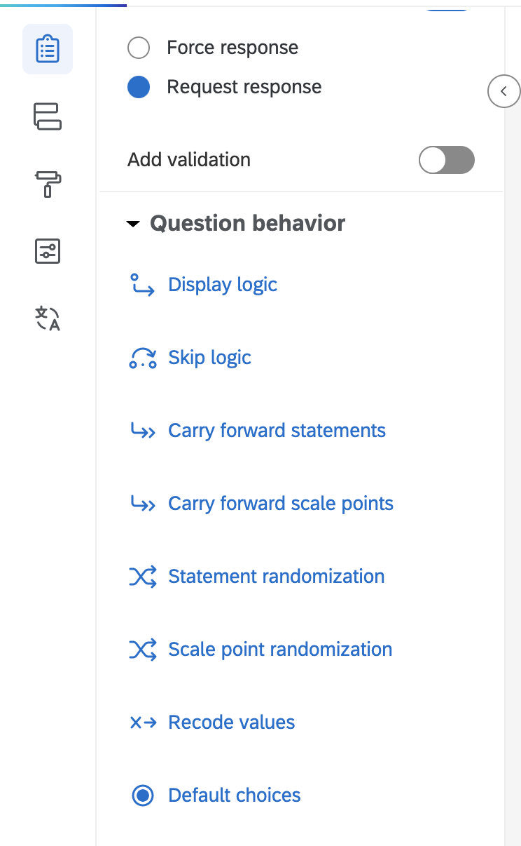
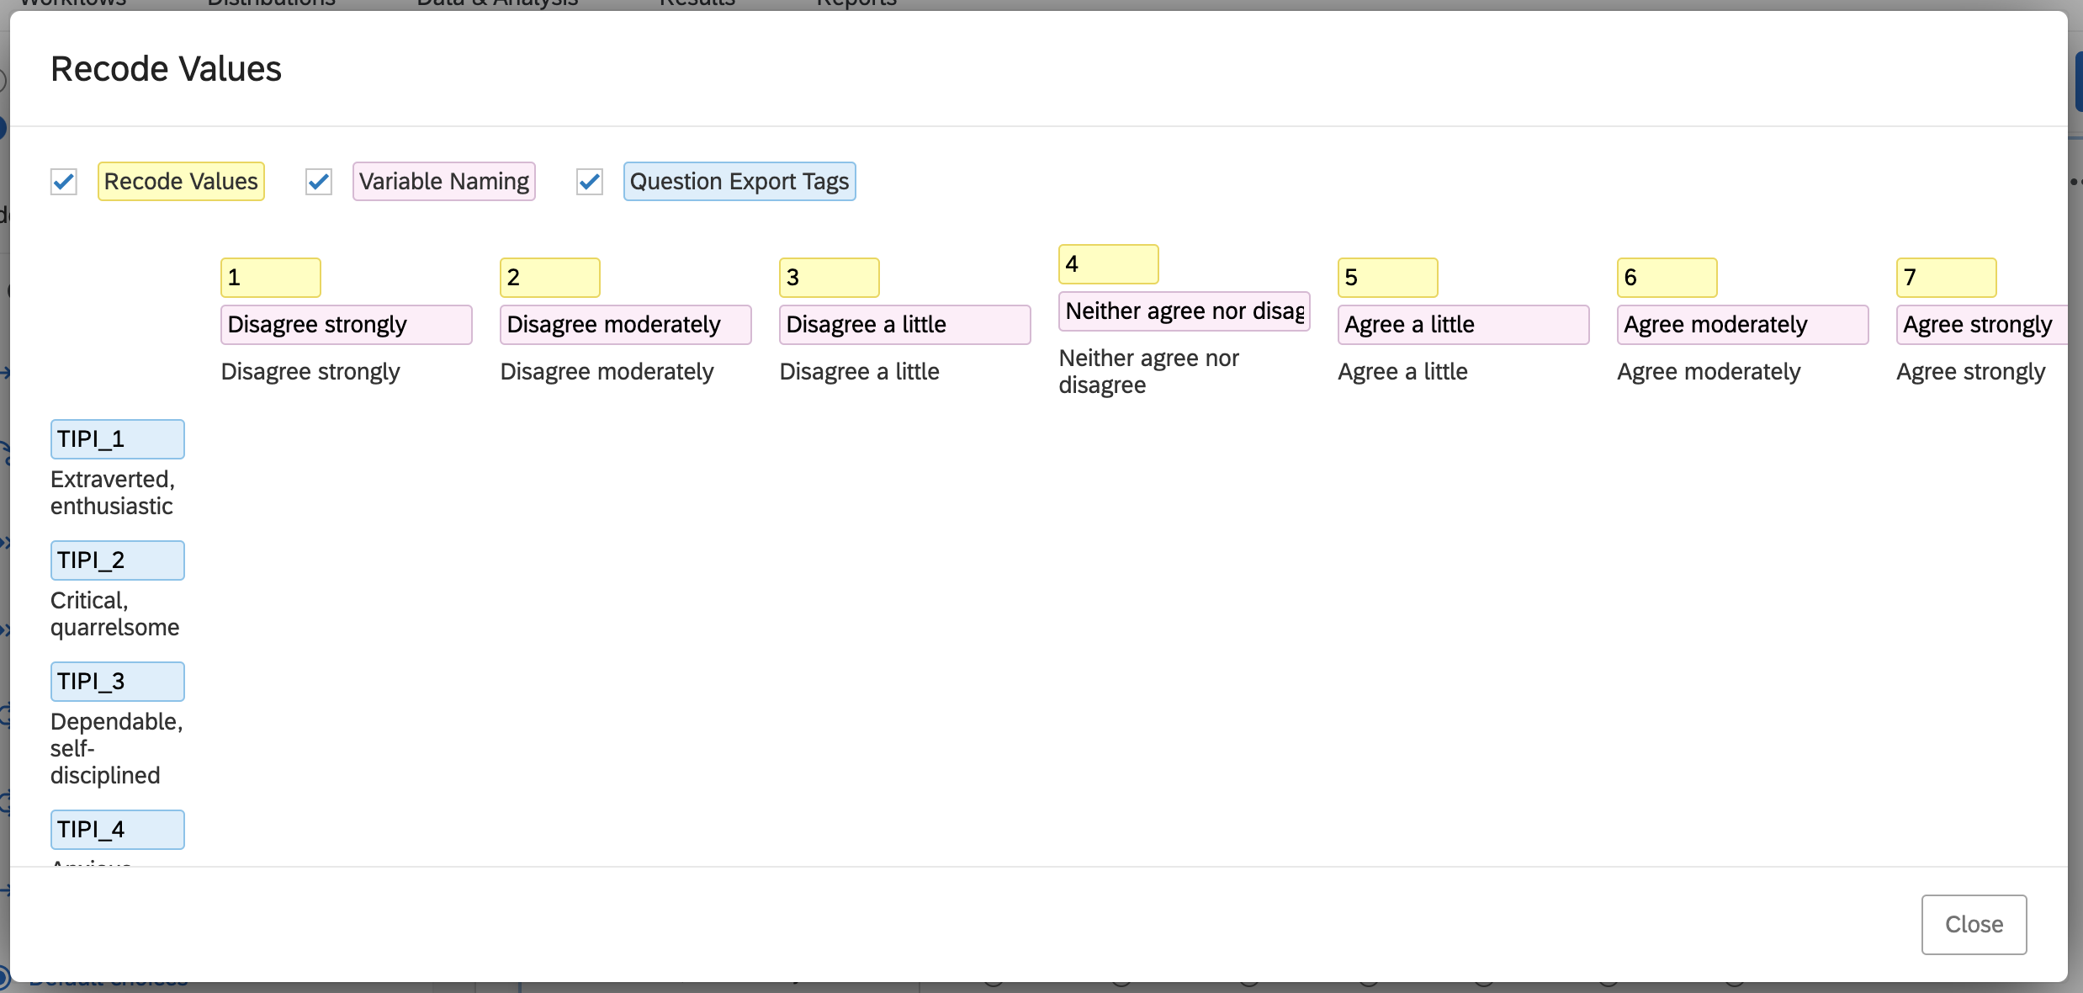
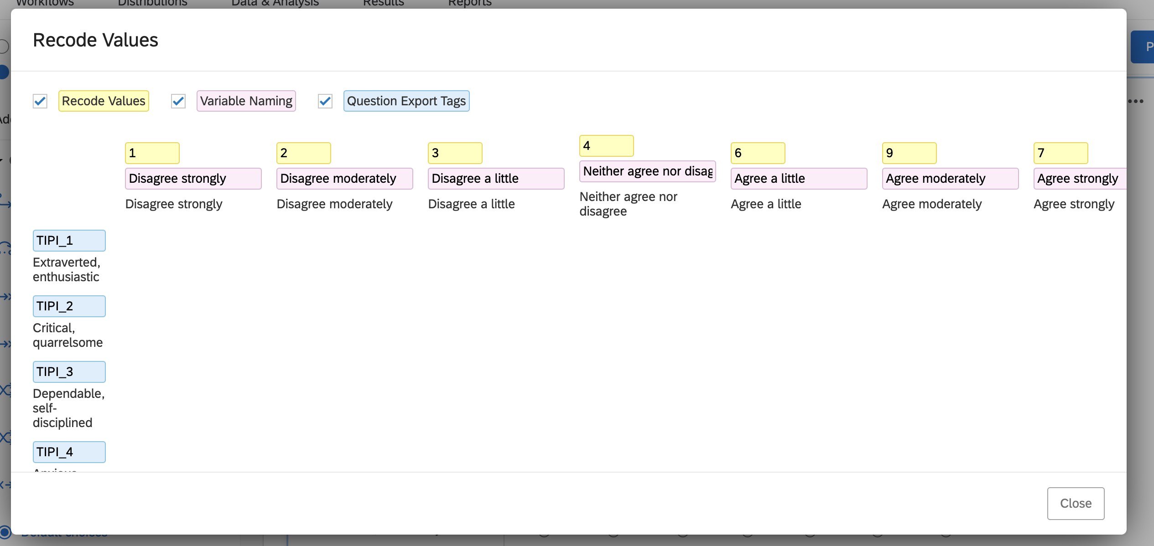
Always Check Recoded Values

Slide 12
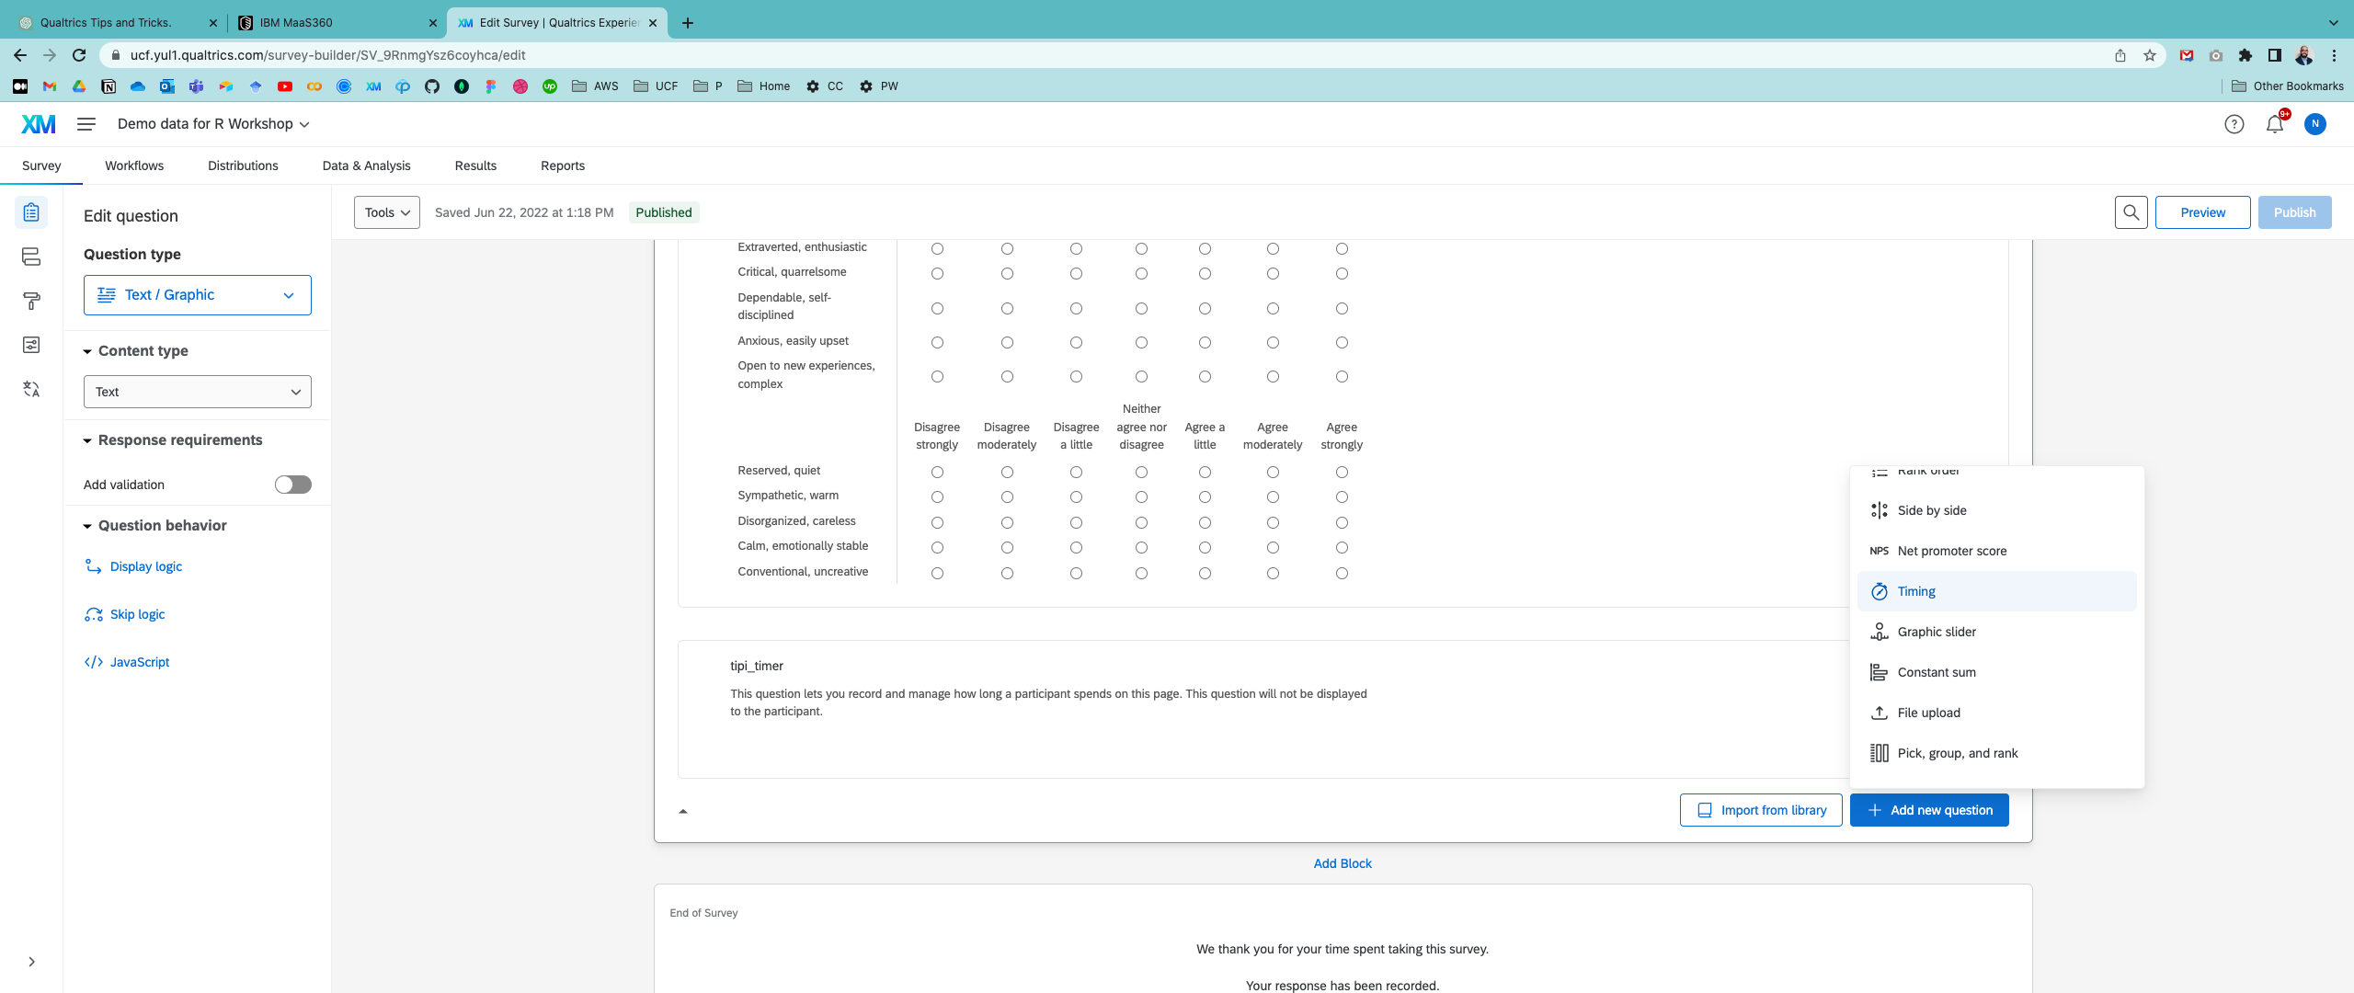
Collect Timing Data
Collecting timing data for each survey screen can provide valuable insights into how respondents engage with your survey and help you optimize your survey design for better data quality and respondent experience.
Bowling, N. A., Huang, J. L., Brower, C. K., & Bragg, C. B. (2021). The quick and the careless: The construct validity of page time as a measure of insufficient effort responding to surveys. Organizational Research Methods, 10944281211056520.

Slide 13
Collect Timing Data
Identify survey completion time: Timing data can help you identify how long it takes respondents to complete your survey.
Improve survey design: Identify which survey questions or screens are causing respondents to spend more time.

Slide 14
Collect Timing Data
Compare results across groups: Timing data can provide insights into how different groups of respondents engage with the survey and how to tailor the survey for different audiences.

Slide 15
Collect Timing Data
Monitor respondent engagement: Are respondents spending an unusually long time on a particular screen? This could indicate that they are struggling to understand the question or are not fully engaged.

Slide 16
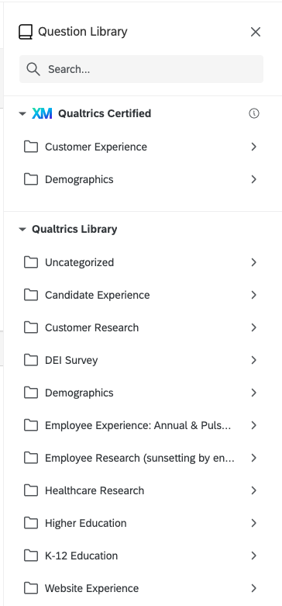
Using the Qualtrics Library
Large set of questions for various research applications (e.g., demographics, website experience)

Slide 17
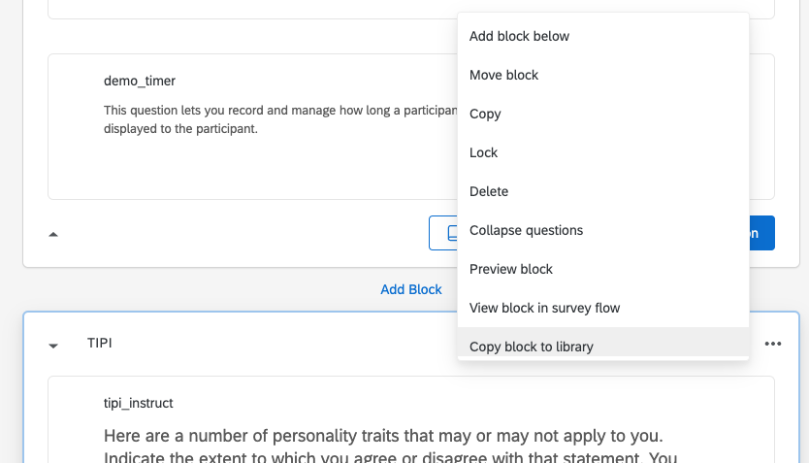
Building YOUR Qualtrics Library

Slide 18
Attention Check Questions
Instructional Manipulation Checks
IMCs explicitly instruct a participant to complete a task in a certain way, and are therefore designed to see whether or not a participant has paid attention to the question being asked.
Nonsensical questions
Only one or two responses to the question's options can be justified as objectively correct (see Paolacci, Chandler, & Ipeirotis, 2010).
Notes:
https://researcher-help.prolific.co/hc/en-gb/articles/360009223553-Prolific-s-Attention-and-Comprehension-Check-Policy#h_01FS4DYYVP24GDYK7D0A8PSYF8
https://www.prolific.co/blog/qualtrics-surveymonkey-prolific-higher-quality-data

Slide 19
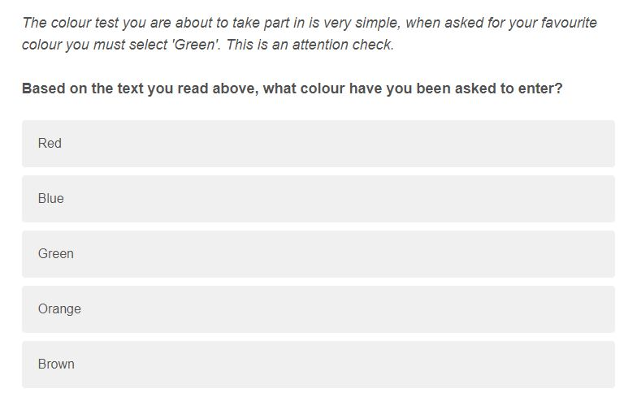
Instructional Manipulation Check (IMC)
This tests whether a participant has paid attention to the question itself.
The participant is informed that their attention is being tested
The correct response is clearly defined - select Green - rather than being open to misinterpretation
Notes:
https://researcher-help.prolific.co/hc/en-gb/articles/360009223553-Prolific-s-Attention-and-Comprehension-Check-Policy#h_01FS4DYYVP24GDYK7D0A8PSYF8

Slide 20
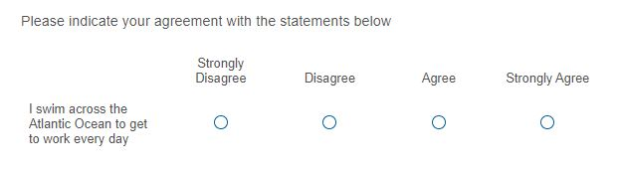
Nonsensical Questions
The statement presented has an objectively correct answer and does not require any prior knowledge
Attentive participants should select 'Strongly disagree', however participants who selected 'Disagree' would also pass
Could you swim across the Atlantic Ocean to get to work every day?
Notes:
https://researcher-help.prolific.co/hc/en-gb/articles/360009223553-Prolific-s-Attention-and-Comprehension-Check-Policy#h_01FS4DYYVP24GDYK7D0A8PSYF8

Slide 21
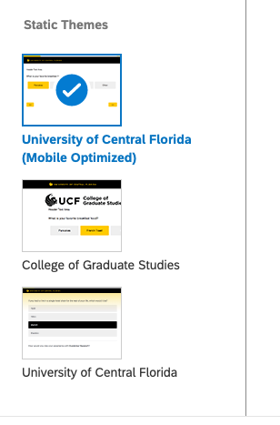
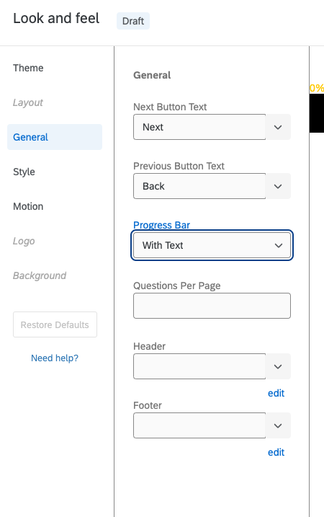
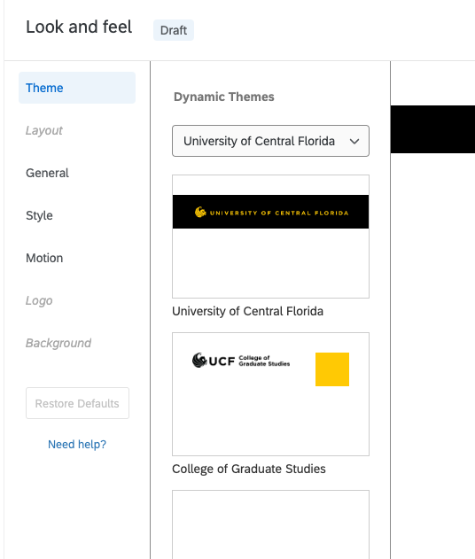
Your survey CAN be visually appealing and user-friendly.

Slide 22
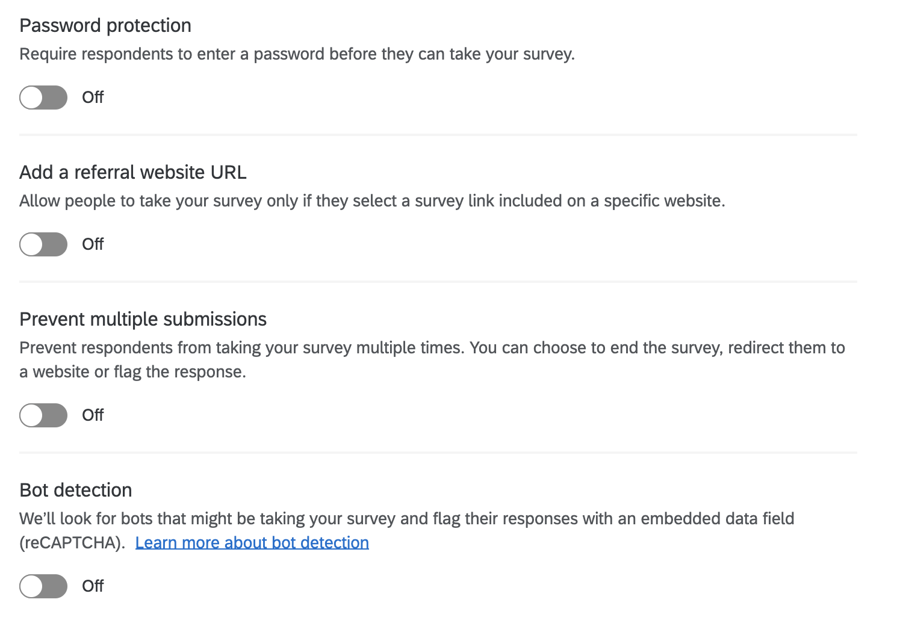
Security & Data Integrity

Slide 23
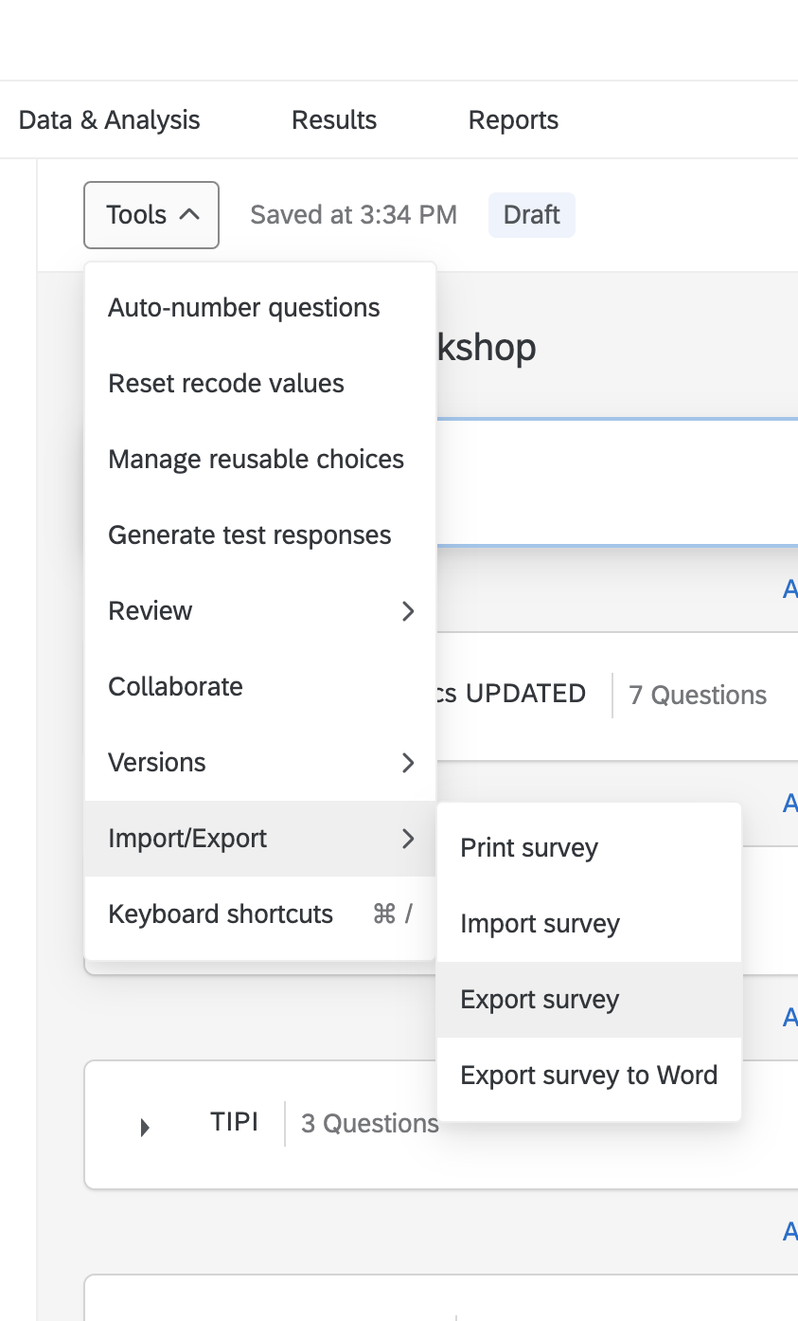
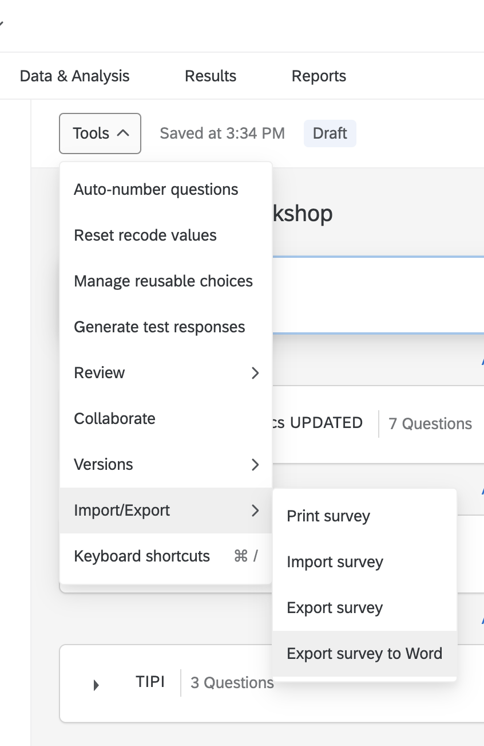
Exporting Surveys

Slide 24
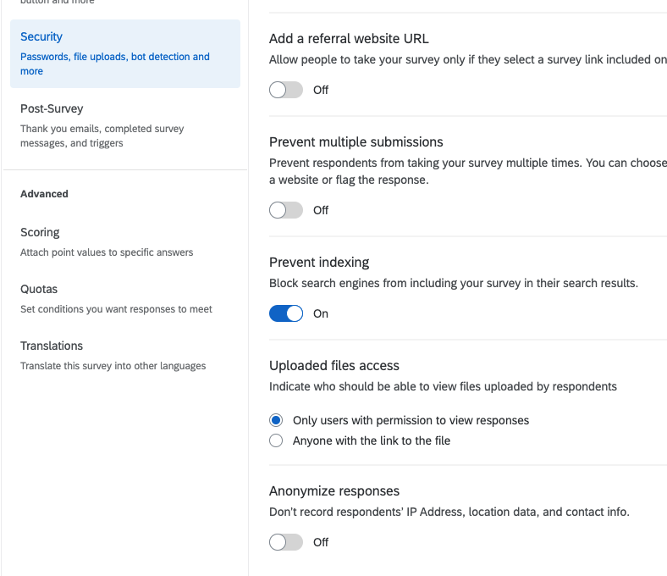
PSA – Anonymize your Qualtrics Surveys
By default, when providing any link that is not listed as anonymous, Qualtrics collects the following information alongside your data
IP Address
Location data
Contact info (if provided)
Turn this off unless needed (and the IRB application lists this data)
Notes:
Demo survey to generate data for workshop: https://ucf.qualtrics.com/jfe/form/SV_9RnmgYsz6coyhca

Slide 25
Advanced Use Cases

Slide 26
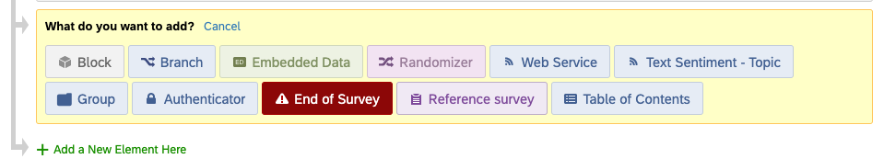
Branching, Randomization, & More
In the Survey Flow tab, click Add a New Element Here to see additional options for customizing your survey experience

Slide 27
Why Branching?
Personalization: Branching can allow the survey to be personalized based on the respondent's answers, creating a more engaging and relevant experience.
Efficiency: Branching can reduce the number of questions that respondents need to answer, making the survey shorter and more efficient.
Conditional Logic: Branching allows for conditional logic, which means that certain questions are displayed based on the respondent's previous answers. This can help to ensure that respondents only see questions that are relevant to them.
A/B Testing: Branching can be used to test different versions of a survey with different groups of respondents, helping to identify the most effective design or content.

Slide 28
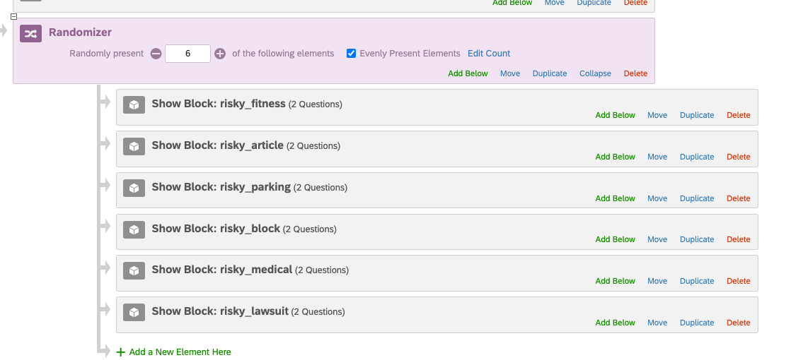
Randomization

Slide 29
Embedded Data
Customizing the survey experience: Embedded data allows you to personalize the survey experience for each respondent by capturing additional data about them. You can use this data to customize survey questions, skip logic, and even survey branching.
Integrating with other systems: For example, you can use embedded data to track survey respondents across multiple surveys or link survey responses to other data sources.
Automation: Embedded data can be used to automate certain tasks within the survey, such as sending email invitations or generating unique respondent IDs. This can help streamline the survey process and reduce the workload for the survey administrator.

Slide 30
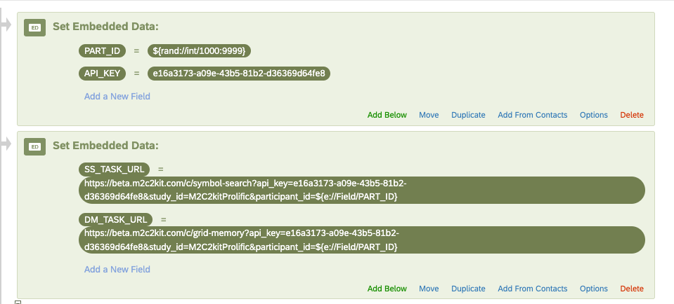
Embedded Data

Slide 31
Embed a task from external source: iFrame
An iFrame, or Inline Frame, is an HTML element that allows for the loading of another HTML element within a web page (e.g., external ads, videos, tags, Figma prototypes, or other interactive elements).
Not all websites may not permit the use of an iFrame to embed their content.

Slide 32
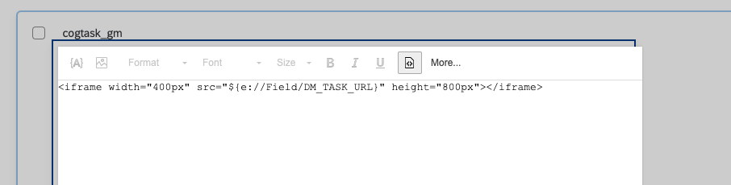
Embed a task from external source

Slide 33
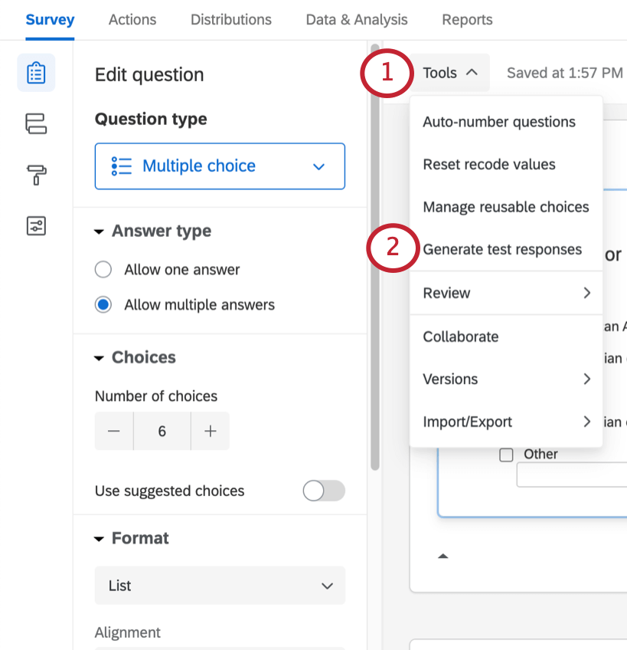
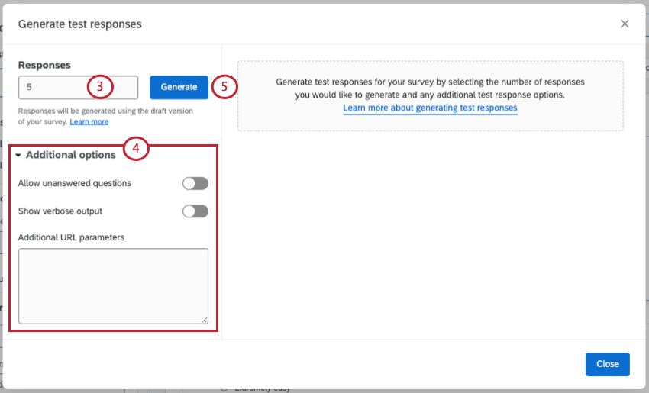
Generate Test Responses

Slide 34
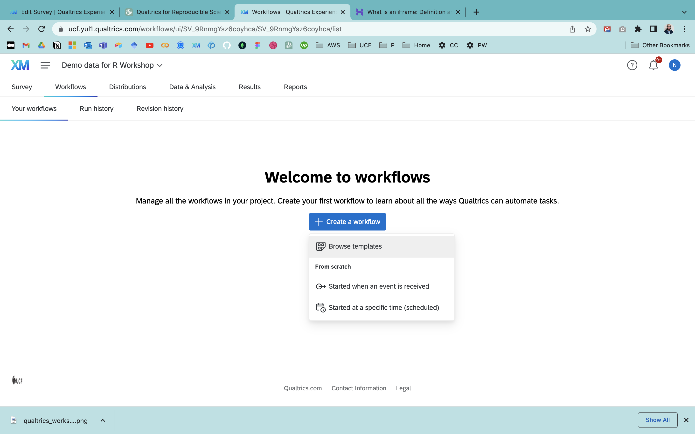
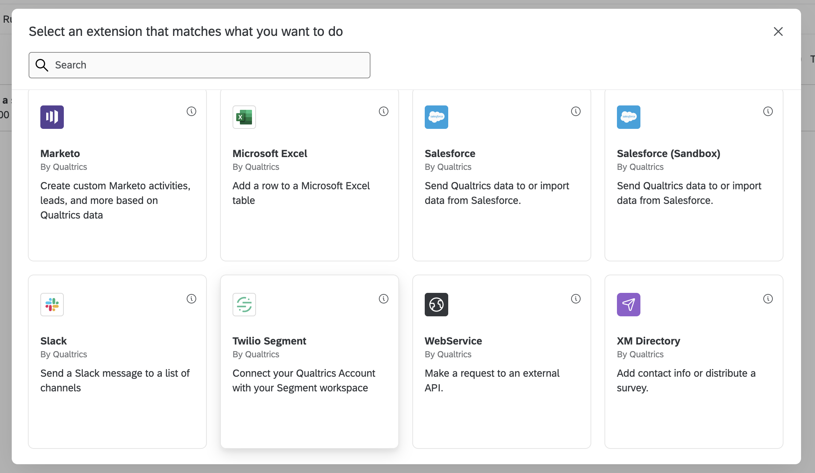
Workflows

Slide 35
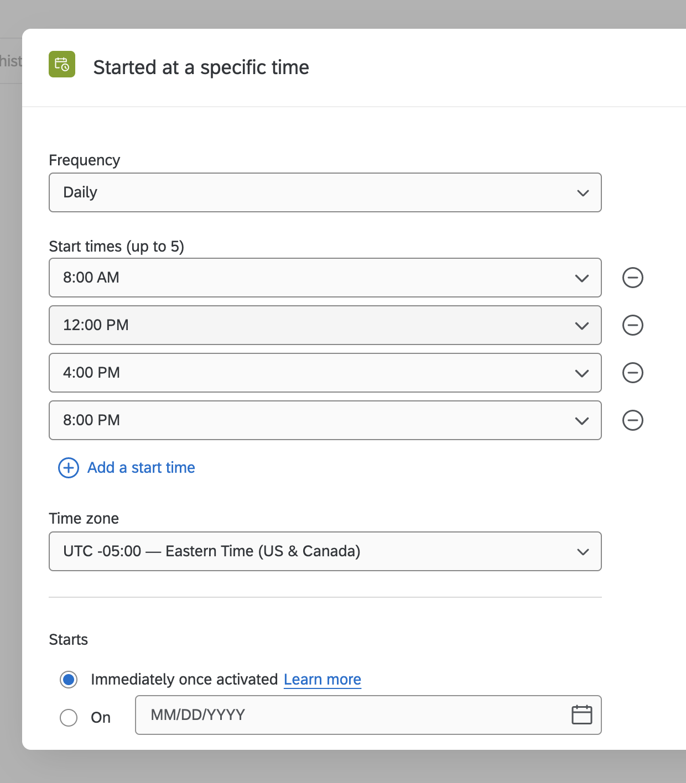
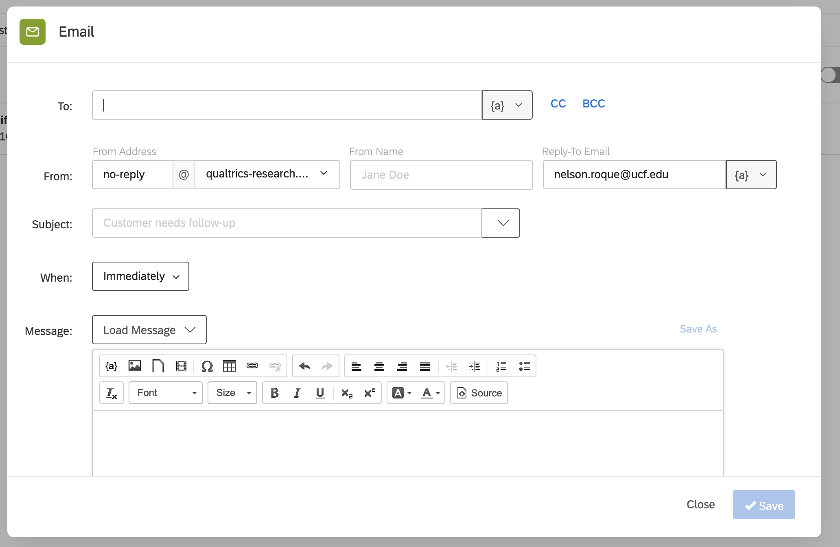
Workflows

Slide 36
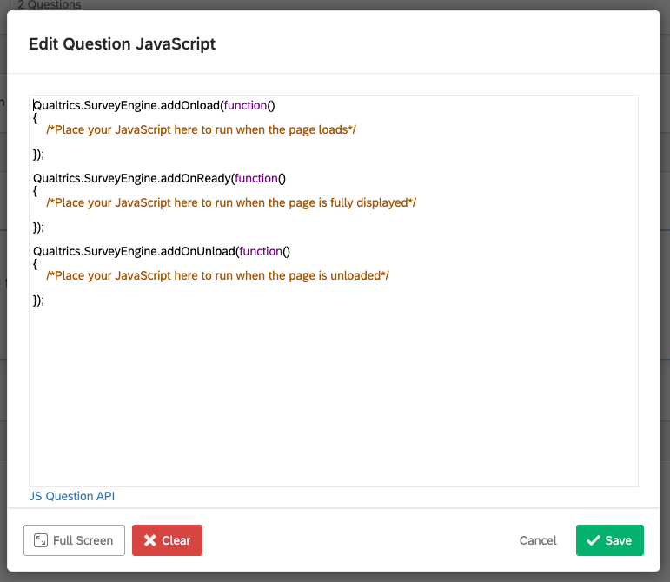
Custom Javascript
Advanced Question Types, and activities
Custom validation
Conditional Logic
Integration

Slide 37
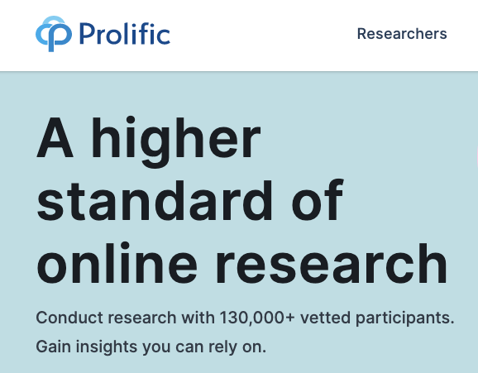
Collecting Data on Prolific
Notes:
In chat, have you used? As poll

Slide 38
Collecting Data on Prolific
Prolific is an online research platform that provides the recruitment and management of participants for online research, to enable fast, reliable and high-quality data collection by connecting diverse participants with researchers.
You can use your existing study/survey software to integrate with Prolific, choose your target respondents with their prescreening and collect hundreds or thousands of responses quickly and easily.
Once you’ve reviewed the data, you can approve and pay the participants with just a few clicks (or automatically).
Notes:
https://www.prolific.co/blog/qualtrics-surveymonkey-prolific-higher-quality-data

Slide 39
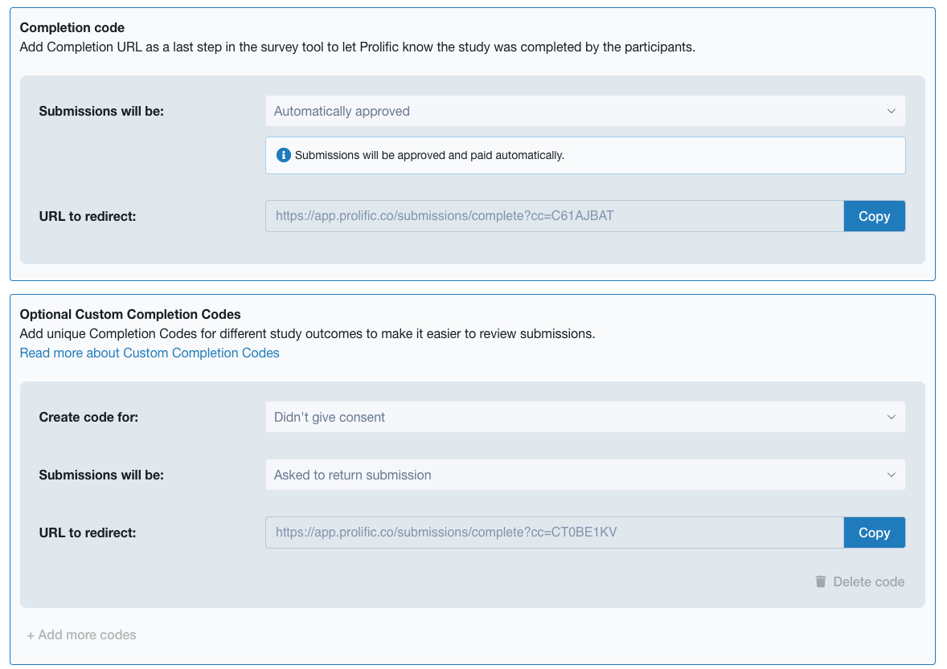
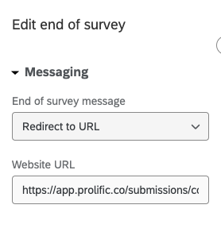
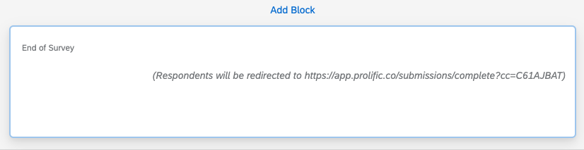
Collecting Data on Prolific
On Prolific
On Qualtrics
Notes:
This is used on SONA as well

Slide 40
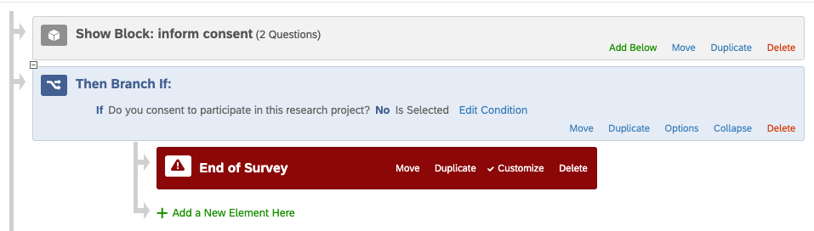
Collecting Data on Prolific
On Prolific
On Qualtrics
Notes:
This is used on SONA as well

Slide 41
Reproducible Data Workflows

Slide 42

Typical Data Science Workflow
Data collection
Source: R for Data Science
Notes:
https://vita.had.co.nz/papers/tidy-data.pdf

Slide 43
What is tidy data?
Every column is a variable.
Every row is an observation.
Every cell is a single value.
participant | condition | avg_response_time | perc_accuracy
9991 | control | 506 | 90
9992 | active | 516 | 96
9993 | control | 526 | 99
Source: R for Data Science
Notes:
https://vita.had.co.nz/papers/tidy-data.pdf

Slide 44
Working with Qualtrics Data in R
The triple header problem
Solution: using the qualtRics package
qualtrics_df <- qualtRics::read_survey(filename)
Notes:
Demo survey to generate data for workshop: https://ucf.qualtrics.com/jfe/form/SV_9RnmgYsz6coyhca

Slide 45
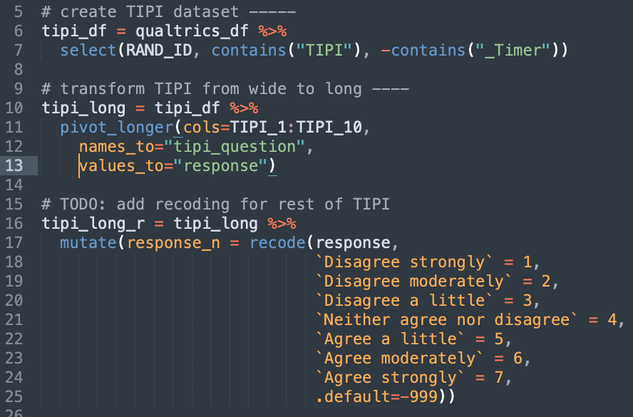
Working with Qualtrics Data in R
Recoding values similarly across many columns at once
Solution: convert data to long format, apply scoring on long-format data and then finally convert back to wide-format

Slide 46

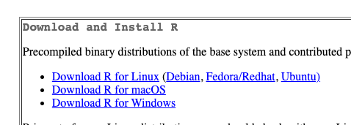
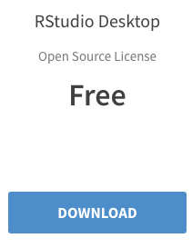

Software Required for Workshop
R
https://cran.r-project.org/
RStudio
https://www.rstudio.com/products/rstudio/download/

Slide 47
Let’s jump into R
Scan the QR code to view the code we will work with
Sample Survey: https://ucf.qualtrics.com/jfe/form/SV_9RnmgYsz6coyhca?SOURCE=ucf_workshop_march2023
Notes:
Scipts we will go over
https://github.com/nelsonroque/contextlab_reproduciblescience_workshops/blob/main/scripts/03-r-basics.Rmd
https://github.com/nelsonroque/contextlab_reproduciblescience_workshops/blob/main/scripts/04-r-pipeline.Rmd
https://github.com/nelsonroque/contextlab_reproduciblescience_workshops/blob/main/scripts/05-date-manipulation.Rmd

Slide 48

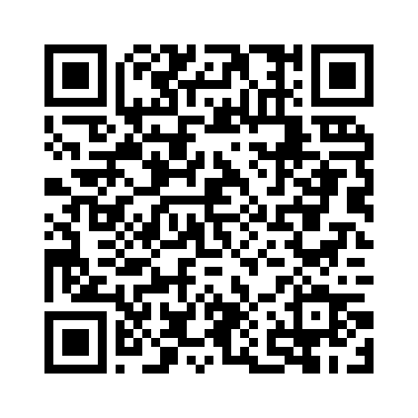
Commitment to Reproducible Science
Train the next-generation of scientists to work with data - regardless of the type, format, or volume.
Make available a set of open-source materials to learn how to engage in reproducible science, leveraging code-based techniques, to support research + data science activities.
https://nelsonroque.github.io/contextlab_introdatascience_webcourse/index.html

Slide 49









nelson.roque@ucf.edu
nelsonroque.com
https://github.com/nelsonroque
thank
you

